Slide 1
Global Corruption
Observations and Modeling
DSI course
Jan 2024
By:
JR Garvin
Tanner Zuleeg
Massoud ‘Massi’ Alfi

Slide 2
Corruption Perception Index (CPI)
Corruption is defined as the abuse of entrusted power for private gain.
Corruption Perception Index (CPI):
A score introduced by Transparency International to measure how corrupt each country’s public sector is perceived to be.
0 to 100
High scores means less corrupt
Notes:
According to the Transparency International, each country’s score is a combination of at least 3 data sources drawn from 13 different corruption surveys and assessments. These data sources are collected by a variety of reputable institutions, including the World Bank and the World Economic Forum.

Slide 3
Problem Statement
How are countries around the world fighting corruption?
Is global corruption improving over time?
Can we model/predict corruption?
What we did and why is it important?
Notes:
In this project, we will be using some of the data published by Transparency International Organization that compiles the corruption perception index for different countries in the world and try to see whether these numbers could be correlated to some other information about those countries. The information that was used to predict the corruption index in each country included, but was not limited to: wealth of the country, political indicators, press freedom, levels of education, unemployment, gender inequality, general healthcare and wellness indicators, quality of life, ethnic and religious division and social norms.
Being able to model the corruption index is important because usually, it is not something most countries collaborate for conducting surveys or related data collection methods. In addition to that, modeling and predicting corruption could impact the economic growth of a country by increasing costs, lowering productivity, and influencing the investment risks in that country. On top of that, knowing the factors that are correlated with corruption in a country could help us dive deeper into the roots of why corruption happens in certain regions and what could be done to remedy this issue

Slide 4
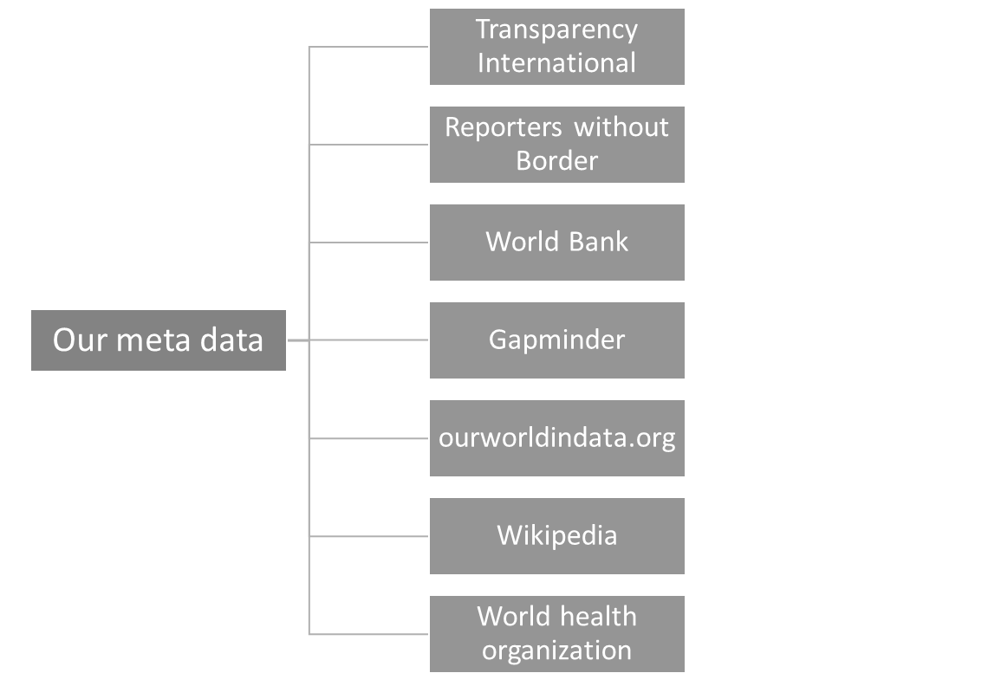
Our Data (to be fixed)
What we used to predict global corruption?
Wealth of the country
Political indicators
Press freedom
Quality of life indicators
Ethnic and religious division
Social norms
Public health indicators

Slide 5
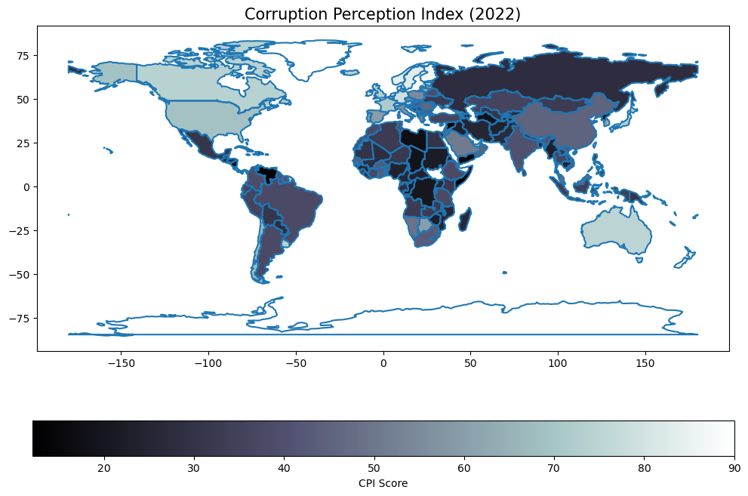
CPI in 2022
Different regions

Slide 6
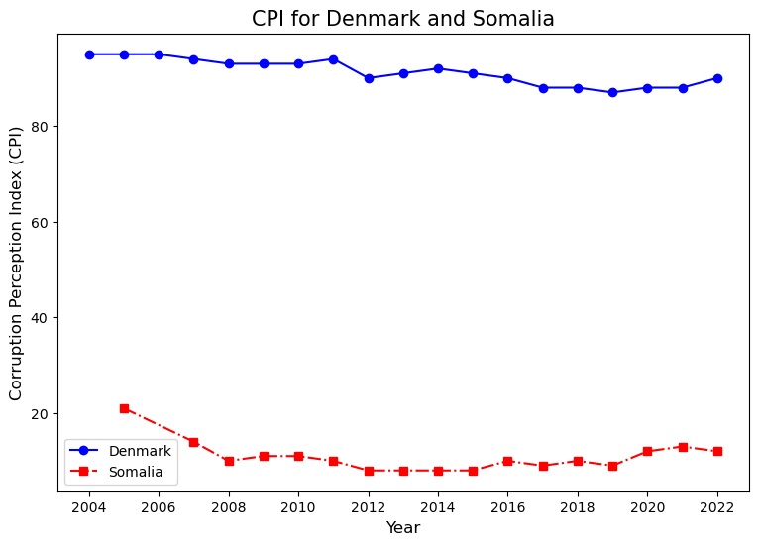
Goods and not Goods in 2022
Last 10 years for the first and last countries
No improvements

Slide 7
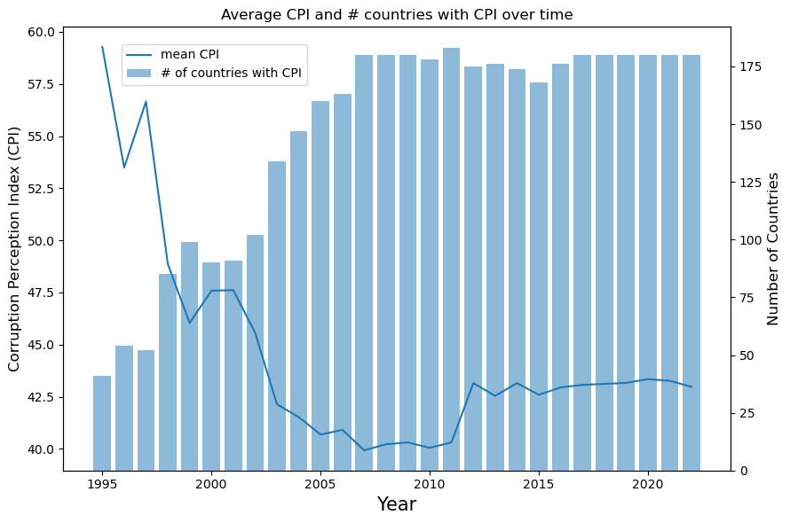
How is the World Doing?
World average is going down
55 countries had their decade’s minimum in 2022

Slide 8
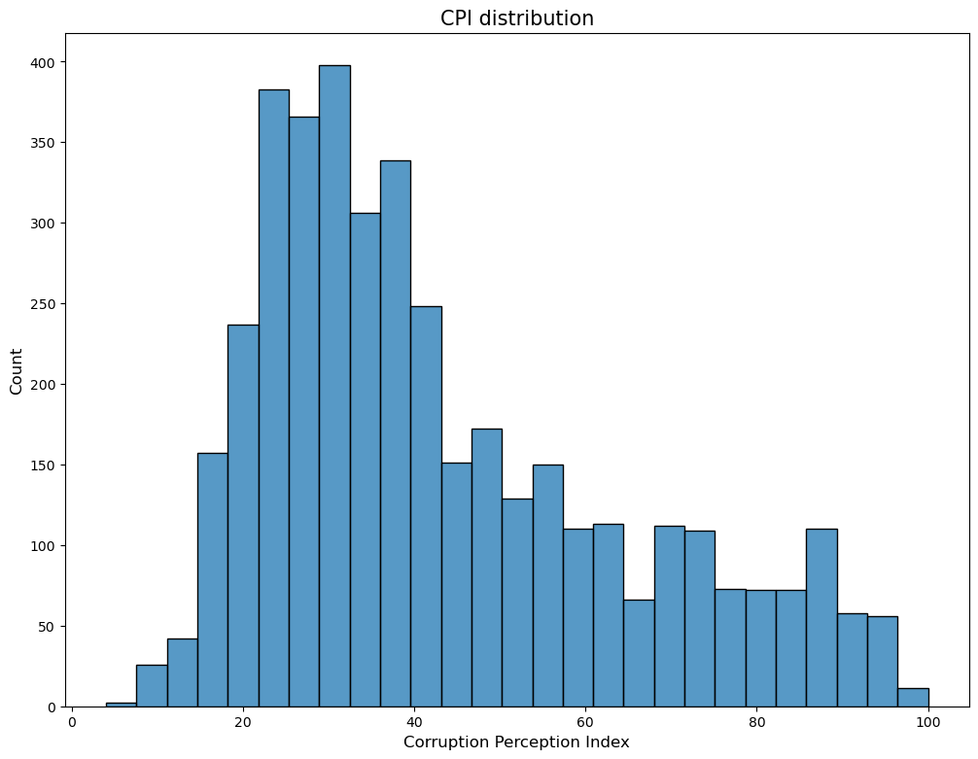
Overall CPI Distribution
Right skewed
No outliers

Slide 9
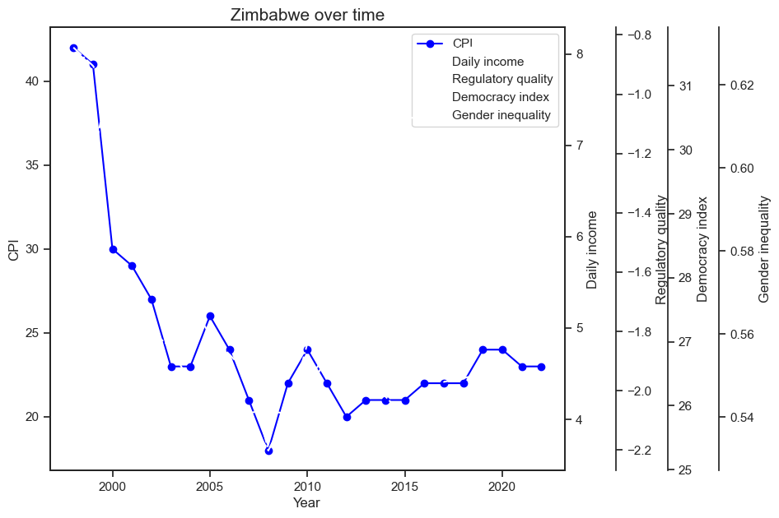
Zimbabwe over Time
Notes:
Let us look at some countries that show dramatic change over time to see if we can find some trends there.
we will start with Zimbabwe

Slide 10
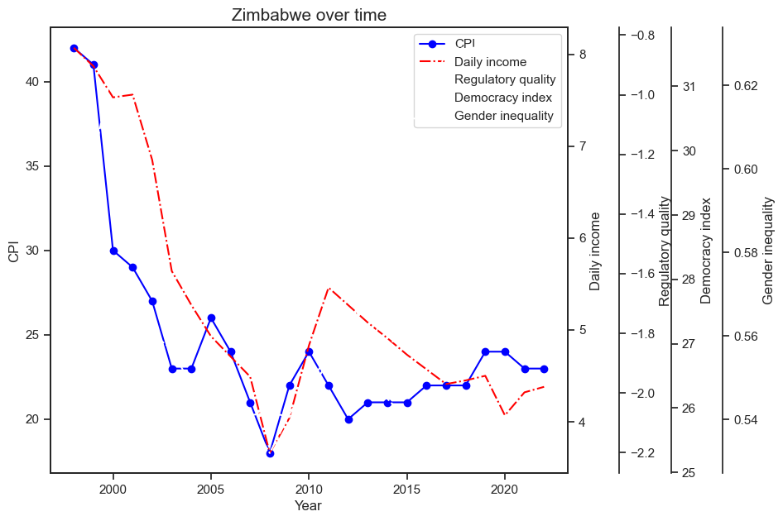
Zimbabwe over Time
Notes:
Let us look at some countries that show dramatic change over time to see if we can find some trends there.
we will start with Zimbabwe

Slide 11
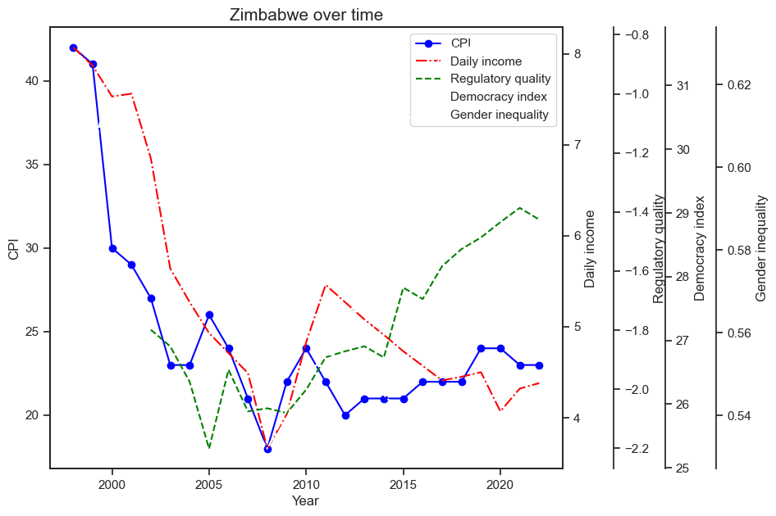
Zimbabwe over Time
Notes:
Let us look at some countries that show dramatic change over time to see if we can find some trends there.
we will start with Zimbabwe

Slide 12
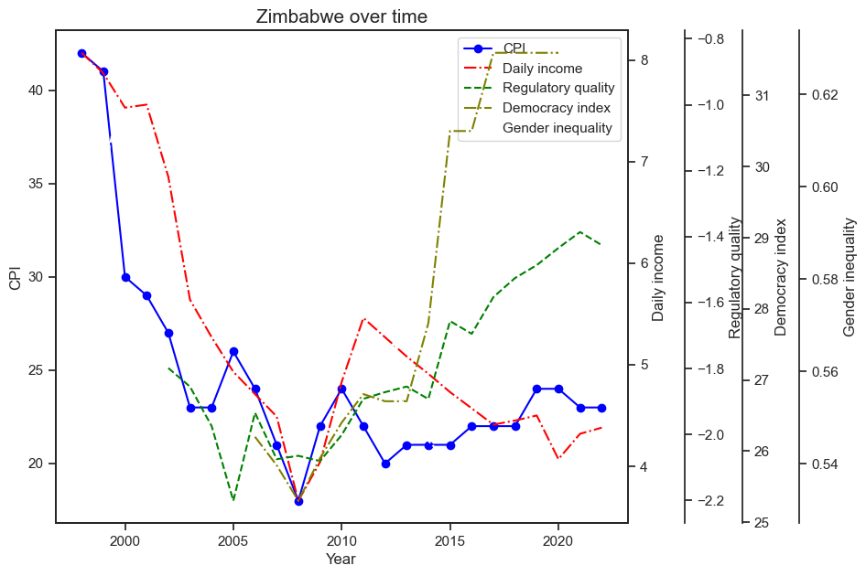
Zimbabwe over Time
Notes:
Let us look at some countries that show dramatic change over time to see if we can find some trends there.
we will start with Zimbabwe

Slide 13
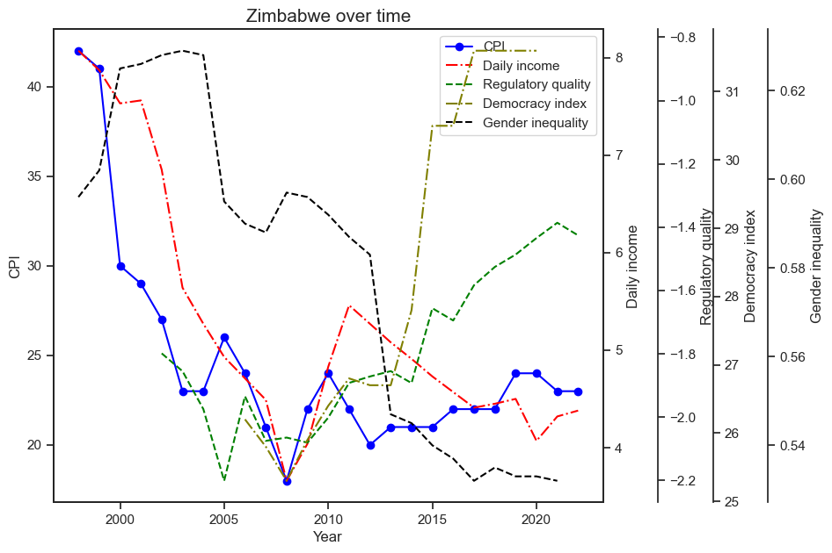
Zimbabwe over Time
Notes:
Let us look at some countries that show dramatic change over time to see if we can find some trends there.
we will start with Zimbabwe

Slide 14
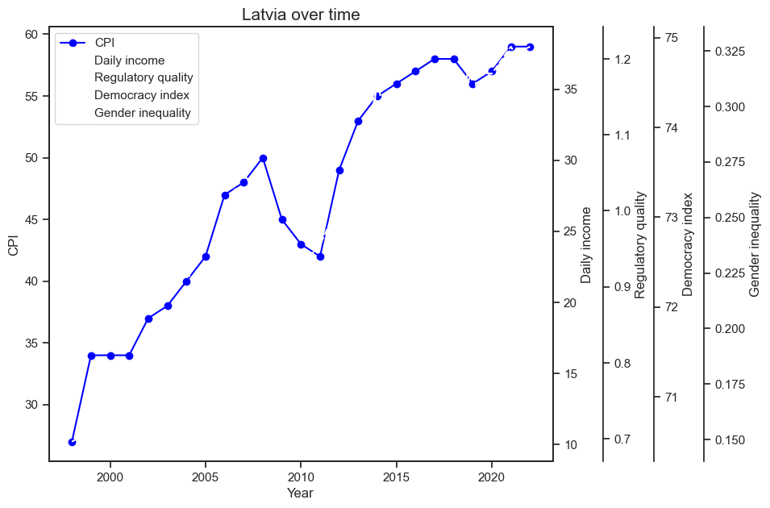
Latvia over Time

Slide 15
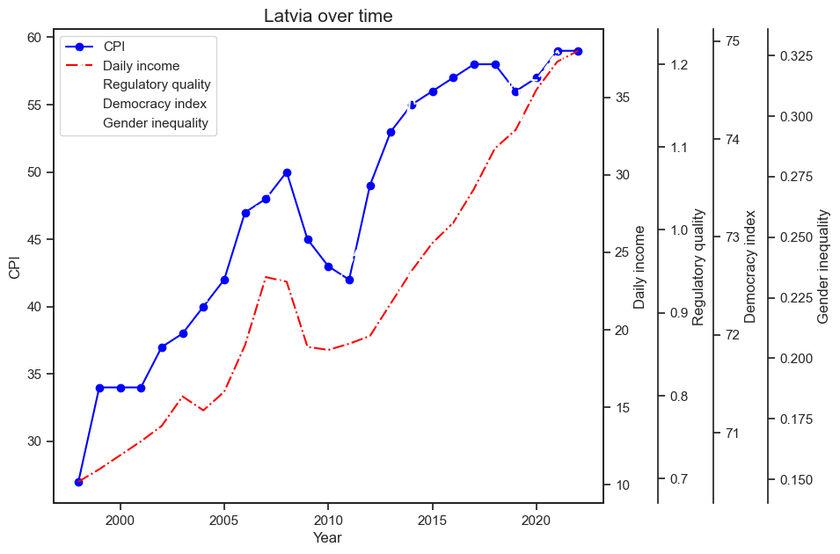
Latvia over Time

Slide 16
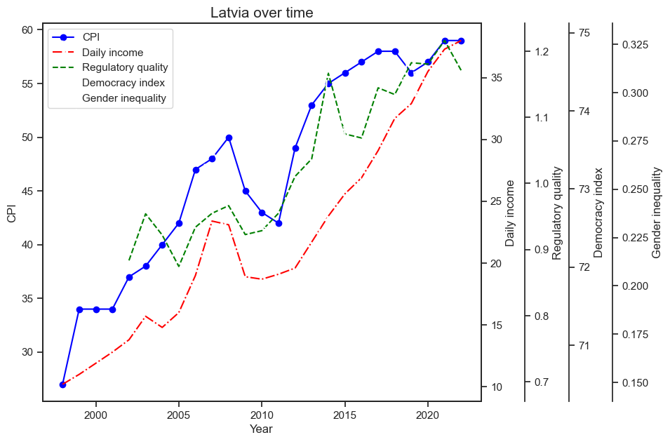
Latvia over Time

Slide 17
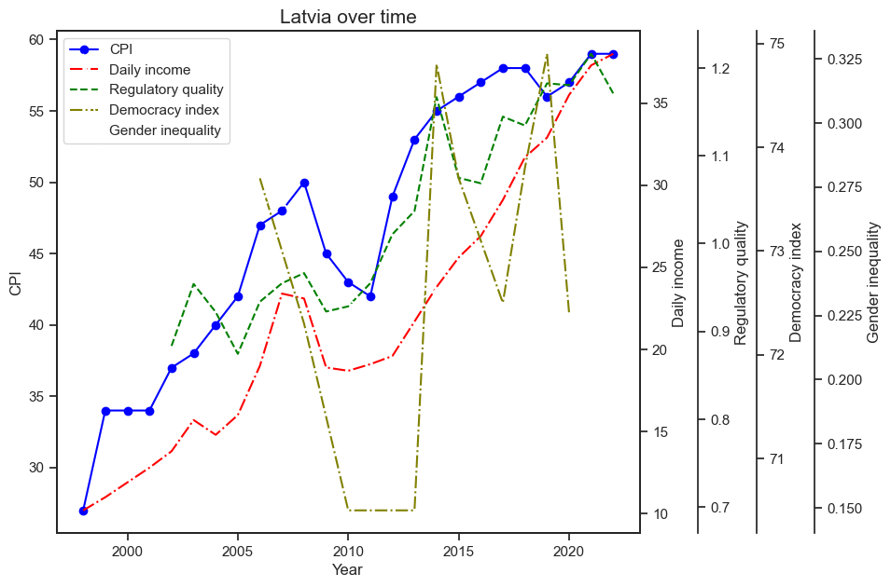
Latvia over Time

Slide 18
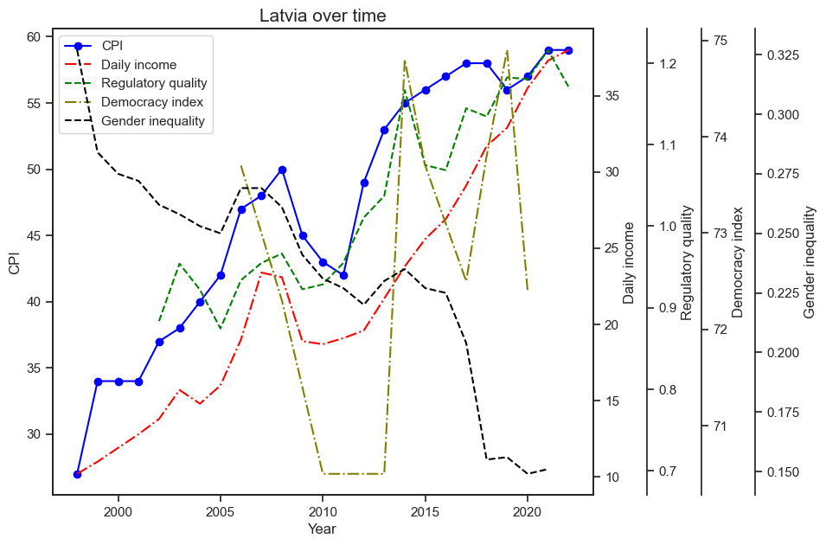
Latvia over Time
Daily income
Regulatory quality

Slide 19
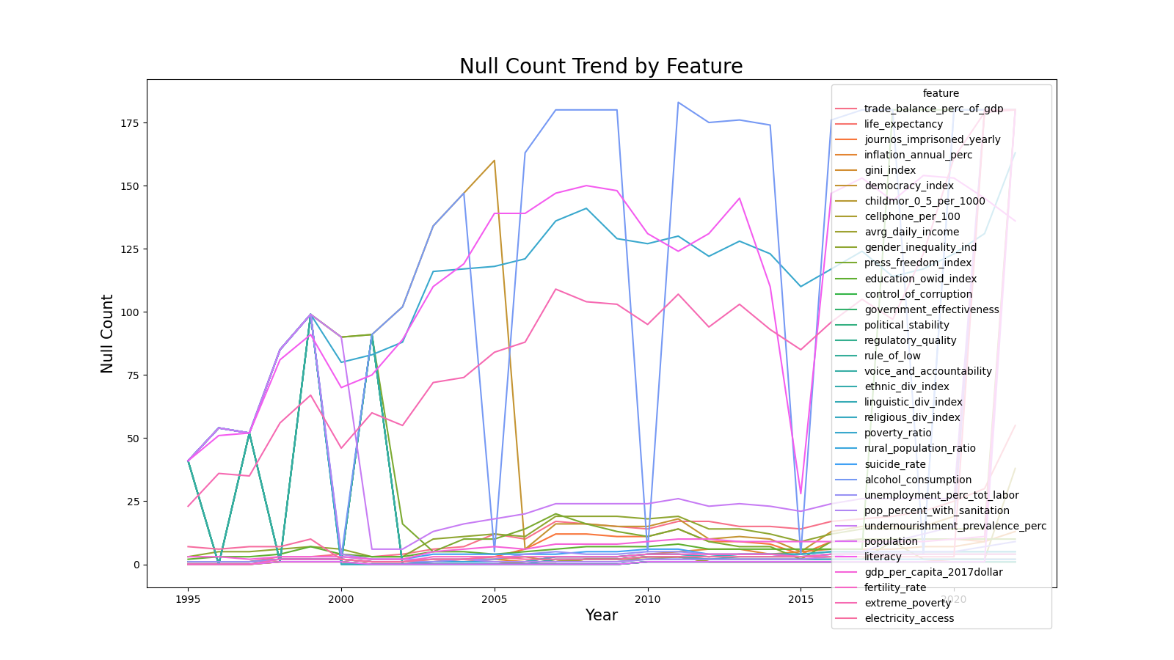
Reconcile Nulls
Drop rows w/o CPI
34 features
4068 rows
Notes:
Dropped all rows without target, CPI. Created plot that illustrated number of nulls per year by feature.

Slide 20
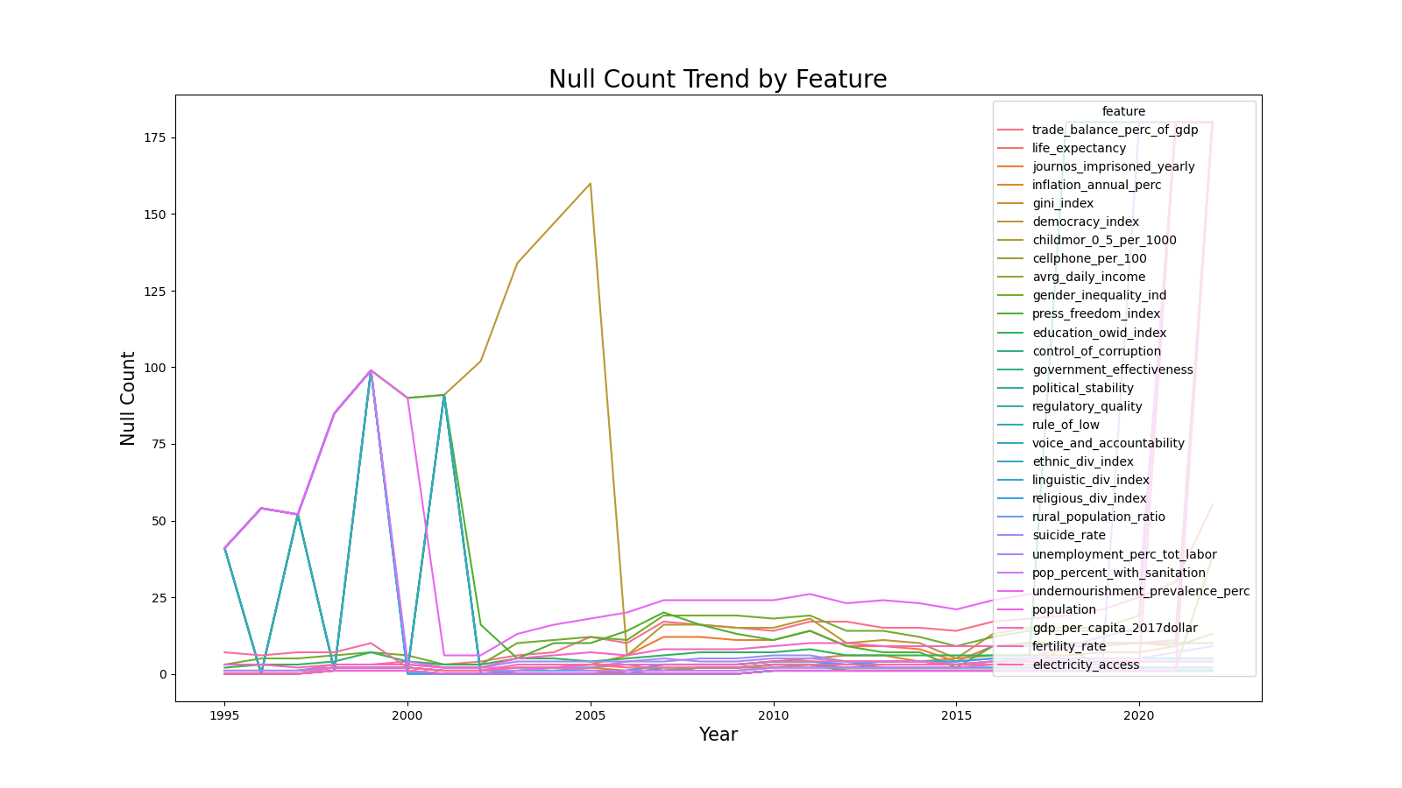
Reconcile Nulls
Drop 4 columns
30 features
4068 rows
Notes:
Dropped the 4 worst features with regards to null count per year. ['literacy', 'alcohol_consumption', 'poverty_ratio', 'extreme_poverty']

Slide 21
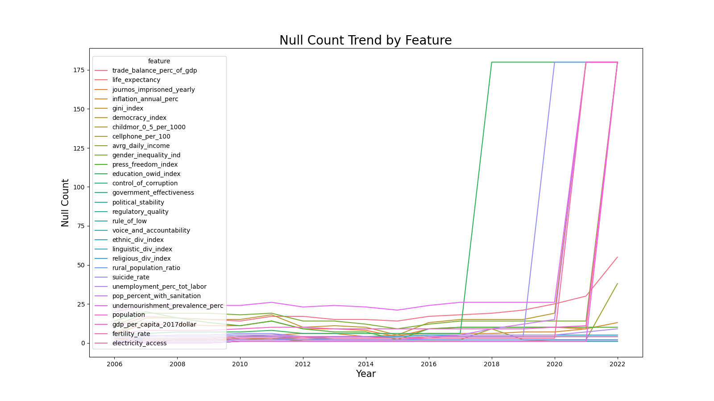
Reconcile Nulls
Drop data prior to 2006
30 features
3013 rows

Slide 22
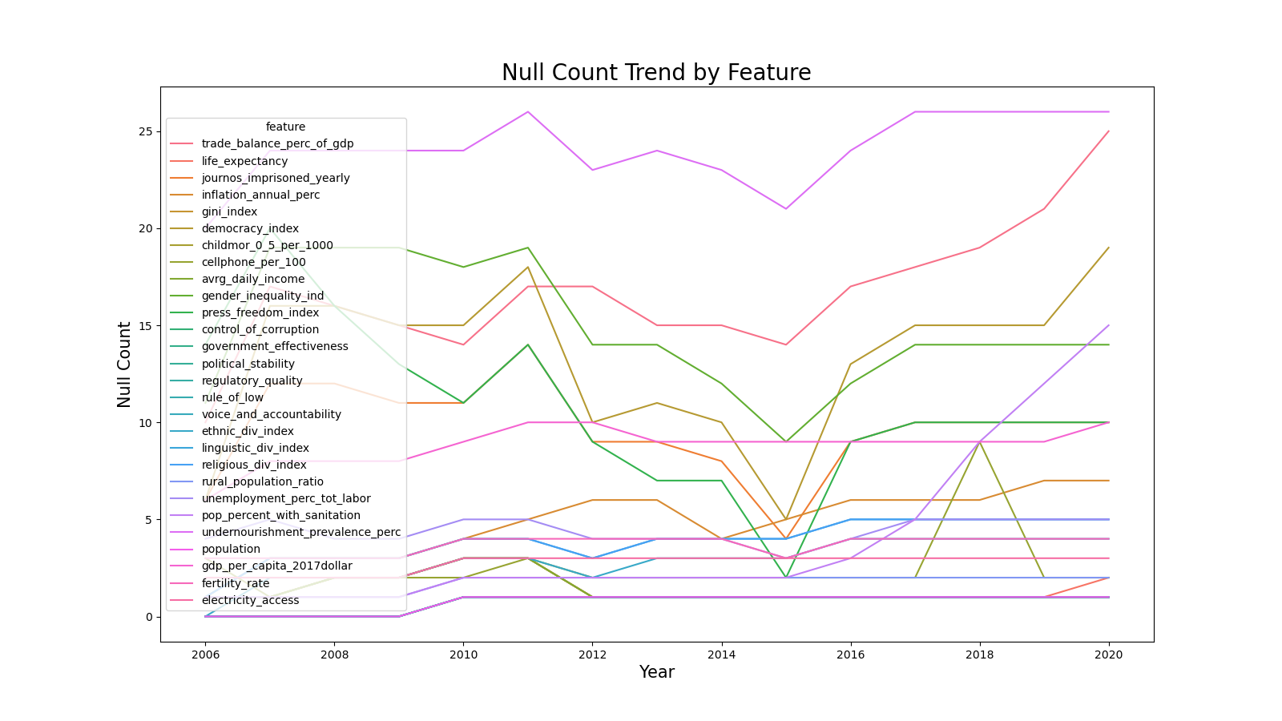
Reconcile Nulls
Drop data after 2020
Drop 2 columns
28 features
2653 rows
Notes:
dropped ['education_owid_index', 'suicide_rate']

Slide 23
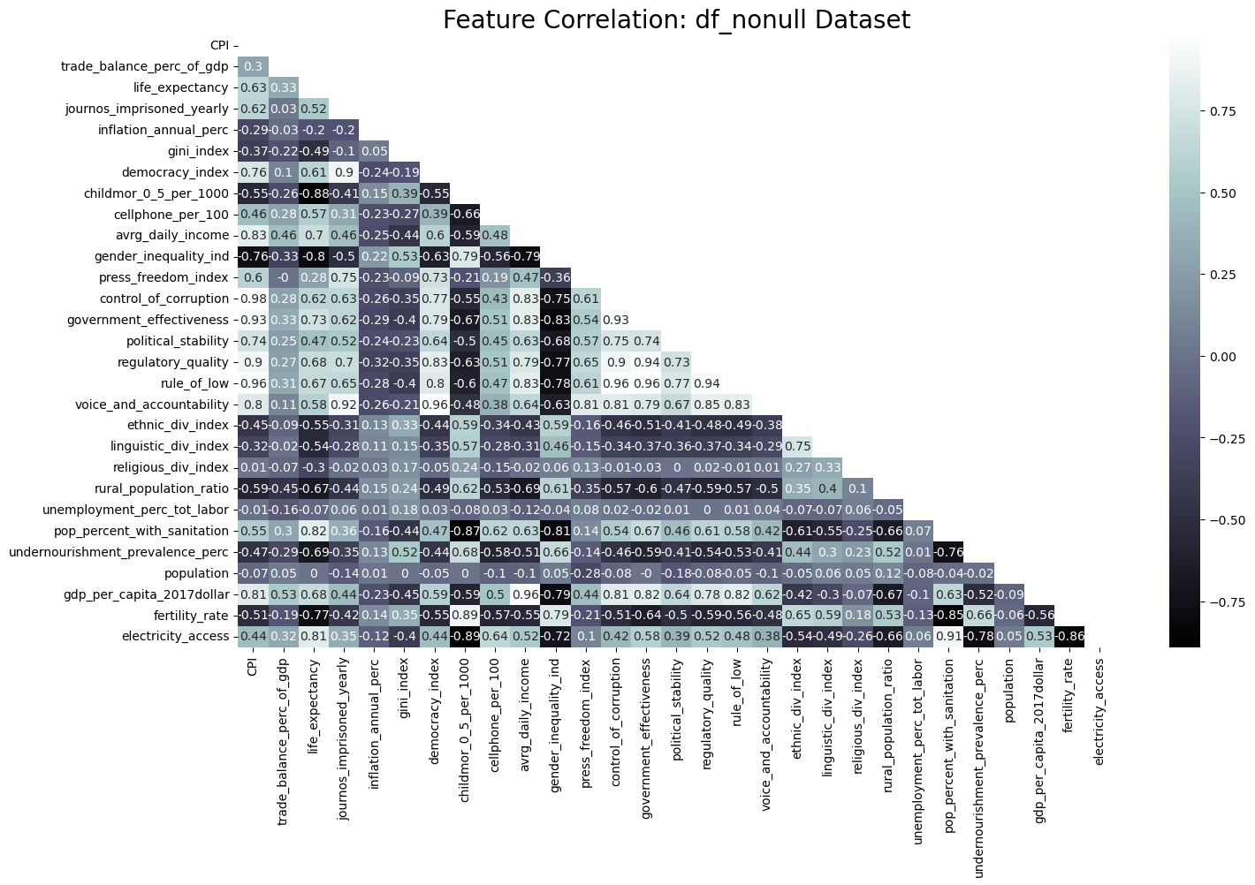
Collinearity Reduction
Drop eight features, correlation issues
20 features
1859 rows after drop nulls
Notes:
Several features show extreme correlation with CPI, 'control_of_corruption','government_effectiveness', 'regulatory_quality', 'rule_of_low', 'voice_and_accountability'. It is likely these features are calculated with similar data as CPI. Decision made to drop these features. Several features show extreme correlation with other features, ie. correlation > 0.90. The worse CPI correlated feature of each of these feature pairs will be dropped.

Slide 24
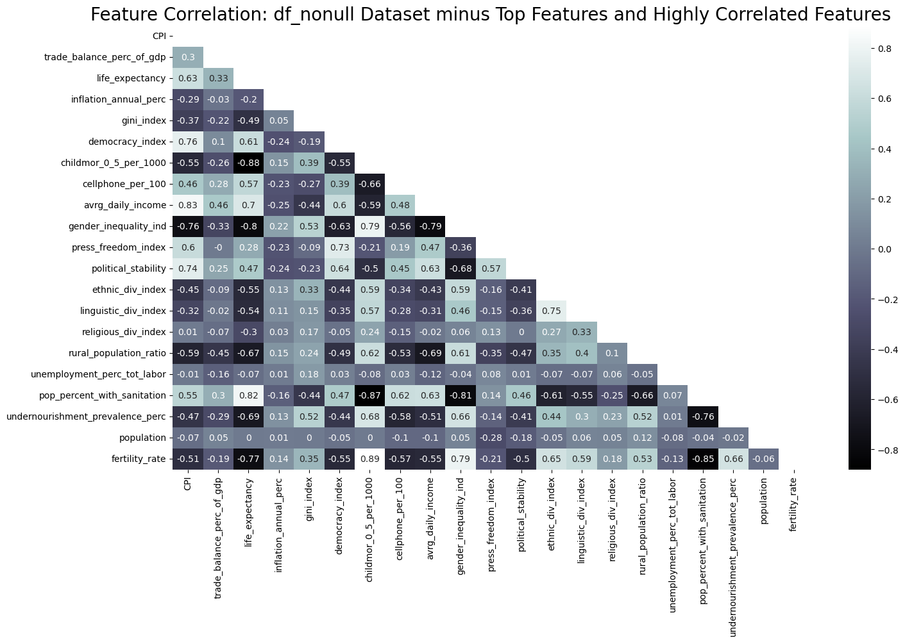
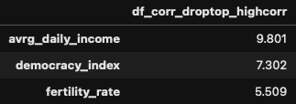
Linear Regression
Training score 0.845
Test score 0.835

Slide 25
Model Optimization
RidgeCV
LassoCV
KNN
Random Forest
Notes:
Modeled cleaned data with four scaled regression models

Slide 26
Model Optimization
RidgeCV
LassoCV
KNN
Random Forest
Train 0.838
Test 0.836
Train 0.837
Test 0.837
Notes:
First two models were similar performance to linear regression

Slide 27
Model Optimization
RidgeCV
LassoCV
KNN
Random Forest
Train 0.838
Test 0.836
Train 0.837
Test 0.837
Train 0.969
Test 0.972
Train 0.970
Test 0.975
Notes:
KNN and random forest performed very well, decision made to try to improve performance with these models

Slide 28
Model Optimization
Boosted
Boosted
KNN
Random Forest
Notes:
boosted KNN and random forest

Slide 29
Model Optimization
Boosted
Boosted
KNN
Random Forest
Train 0.966
Test 0.970
Train 0.974
Test 0.981
Notes:
Knn performed basically the same as non boosted while the random forest improved slightly with a test score of 0.981

Slide 30
Model Optimization
Stacked
Boosted
RidgeCV
LassoCV
KNeighbors
Random Forest
Random Forest
Notes:
tried stacking random forest

Slide 31
Model Optimization
Stacked
Boosted
RidgeCV
LassoCV
KNeighbors
Random Forest
Random Forest
Train 0.974
Test 0.958
Train 0.974
Test 0.981
Notes:
stacking did not perform better than boosting alone

Slide 32
Model Optimization
Stacked
Boosted
RidgeCV
LassoCV
KNeighbors
Boosted
Random Forest
Random Forest
Notes:
modeled stacked and boosted random forest

Slide 33
Model Optimization
Stacked
Boosted
RidgeCV
LassoCV
KNeighbors
Boosted
Random Forest
Random Forest
Train 0.974
Test 0.981
Train 0.972
Test 0.955
Notes:
boosted random forest still wins

Slide 34
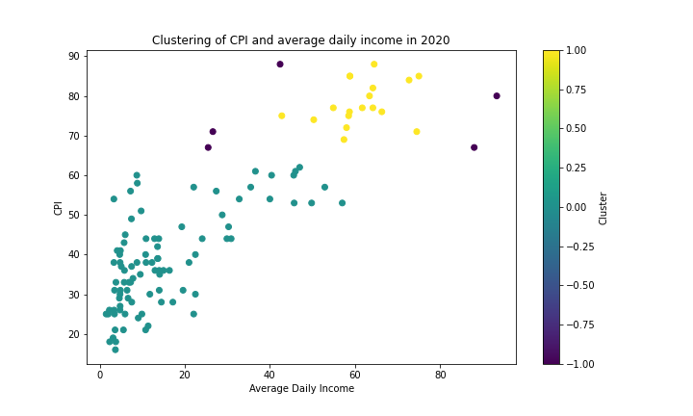
Analysis from clustering
Average daily income versus CPI in 2020
Two clusters
Roughly low and high CPI
Notes:
For the next few slides I will be talking about clustering
I ran a cluster on the top three most significant features from the high performance regression model with CPI for the most recent year in our dataset which is 2020
The reason why I had to do this is because if we kept all our data values, it would not only be hard to see but countries would cluster with themselves over time and we would get vacuous clusters
Here we have average daily income on the x axis and CPI on the y axis
These cluster nicely, giving us two clusters of roughly high and low

Slide 35
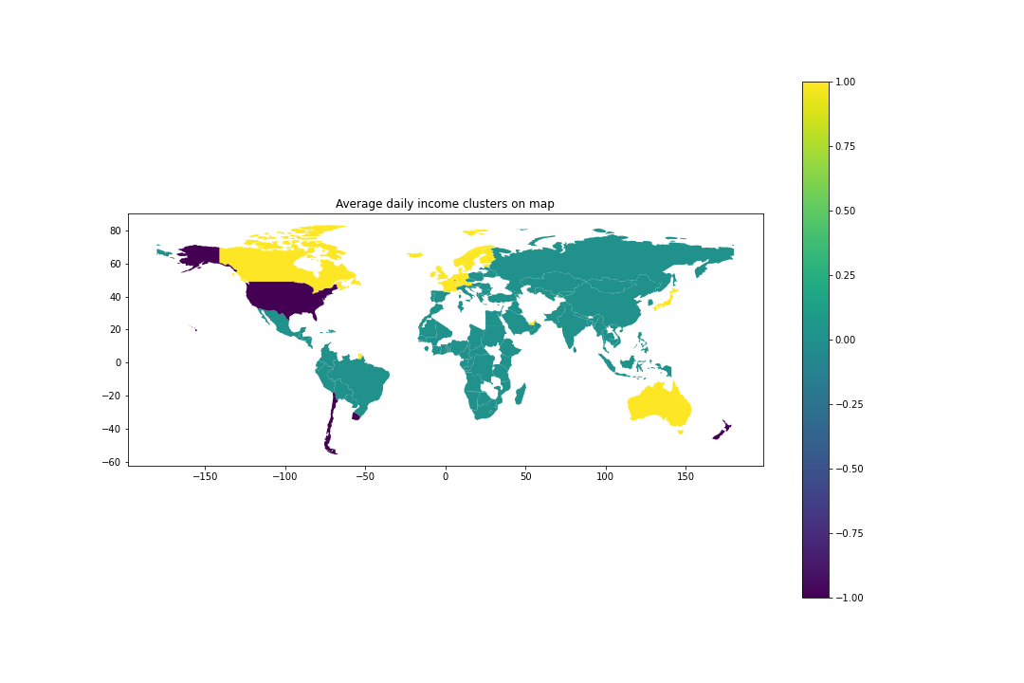
Daily Income clusters visualized
Most of northern Europe, Canada, Japan and Australia
US, Chile, New Zealand (non clusters)
Rest of world
Notes:
Here we see the clusters from before but on the map

Slide 36

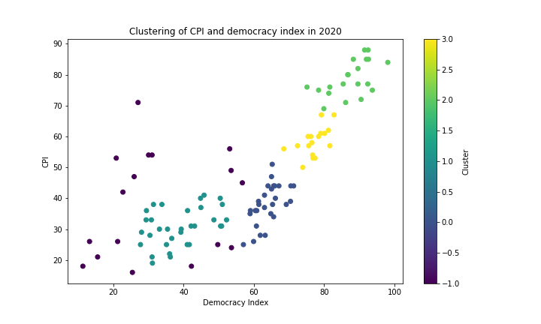
Democracy VS corruption
Four clusters
Ascending order (less corrupt)
Notes:
here we see the scatter plot for democracy versus CPI
as a personal aside, I was very happy to see this scatter plot, because we can see two incredibly complicated phenomenon of human behavior (democracy and corruption) being quantified and when plotted against each other, a great linear relationship. The slope even seems to be about 1. I love it when indexes achieve such intimacy.
here we see four clusters for this plot, again roughly in ascending order

Slide 37
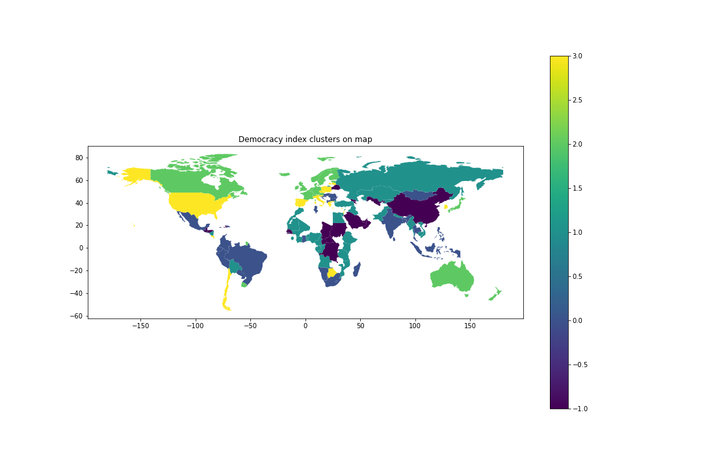
The map for democracy and corruption
Canada with northern Europe and Australia
Notes:
Canada again joining northern europe
keep in mind the dark purple counties are non clusters

Slide 38
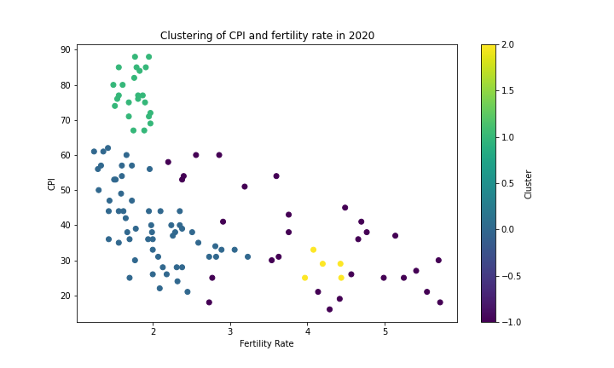
Fertility and Corruption
Many non clusters
A very large cluster
Notes:
Finally we have fertility rate (average number of births per woman) and corruption
The purple noncluster is very large
but so is the blue cluster

Slide 39
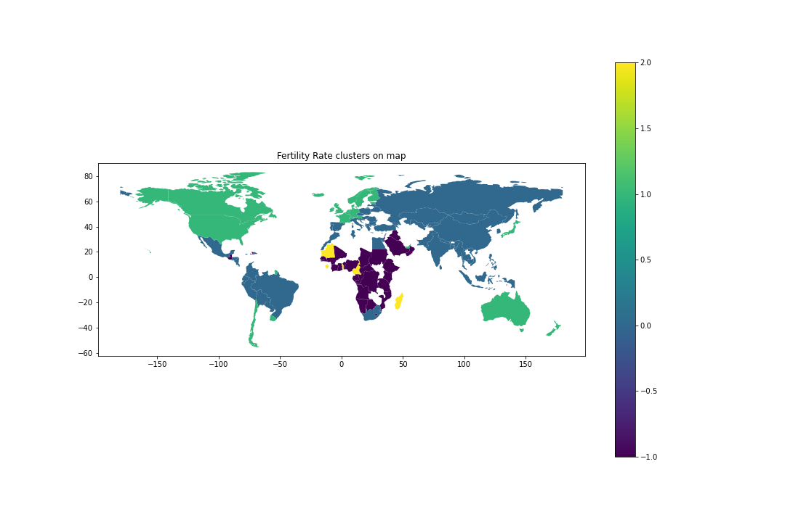
Now on the map
US now with Canada, Northern Europe, Japan, New Zealand and Australia
Huge variety for blue
Notes:
Here is the map, the US now finally joining the european table along with japan and australia
And take a look at that expansive sprawl for blue, what an immaculate cluster, too many to name
The conclusion from the plots for these three different features is that, clustering on these features produces geographical clusters of countries close to each other physically, which is interesting because there is no explicit geographical information embedded in the data we ran a cluster on
If you remember, these were the plots for three highly significant predictors of CPI, and so in this context along with the aforementioned geographical property, we can say that knowing the corruption index of one country will, on average, tell you information about the corruption of the countries near it

Slide 40
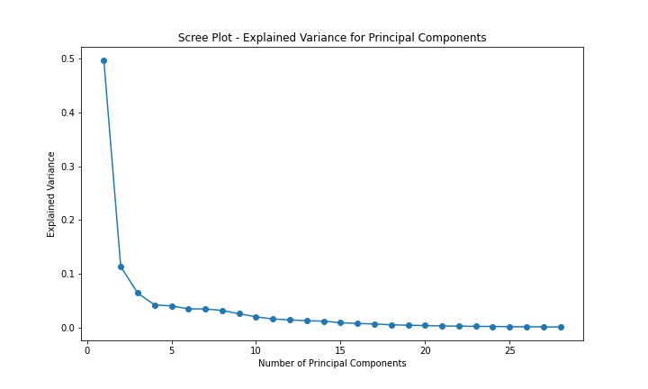
Principle Component Analysis
Elbow at four principal components
Achieved a score of 0.73
Using max amount of components only yields 0.83
Notes:
After all of this modeling and the carefully pondering of the broader implications of corruption in the wake of simply collectable features, it made sense to search for a further pattern in the principle components but, here, I may have caught a glimpse of my folly when I found this to be mostly unintelligible, and achieved a model score of just 0.73 using the optimal number of principal components, which we see there on the elbow as being four and using 20 we only get a model score of 0.83 which is considerably less than our LR model

Slide 41
Conclusions
Corruption is not improving globally with the current trends!
The three most heavily weighted features
were avrg_daily_income, democracy_index, fertility_rate.
Features are geographically clustered as well meaning countries could impact each other
Boosted RandomForest scored highest (0.981).

